Slide 1


OTEL LOGOSU
KAR’S OTEL
SUSTAINABILITY REPORTING

Slide 2
1. INTRODUCTION
1.1. This report has been prepared to transparently present the environmental, social, cultural, and economic sustainability performance of KAR’S Hotel.
1.2. The report has been structured in accordance with the Stage 3 criteria of the Global Sustainable Tourism Council (GSTC).
1.3. During the data collection process, field observations, staff surveys, guest feedback, and environmental monitoring results were used.

Slide 3
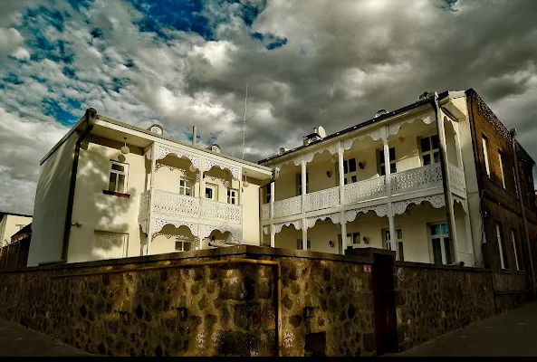
2. HOTEL INTRODUCTION
Different powder tones have been preferred in each room decorated with modern lines. All rooms feature LCD TVs, wireless internet access, and work desks. Additionally, 6-square-meter “king size” beds have been preferred in all rooms, and each room is furnished with specially tailored sheets, covers, and high-quality goose down bedding sets. Hotel guests receive quality service with 24-hour room service. Five of the 8 rooms at Kar's Hotel are standard rooms. In the standard rooms, each floor is decorated with a different dominant color, and every comfort you may need is available. LCD television, telephone, and wireless internet access are standard. Akyaka, Selim, Susuz, Digor, and Kağızman are the standard rooms of Kar's Hotel.
Different powder tones have been preferred in each room decorated with modern lines. All rooms feature LCD TVs, wireless internet access, and work desks. Additionally, 6-square-meter “king size” beds have been preferred in all rooms, and each room is furnished with specially tailored sheets, covers, and high-quality goose down bedding sets. Hotel guests receive quality service with 24-hour room service. Five of the 8 rooms at Kar's Hotel are standard rooms. In the standard rooms, each floor is decorated with a different dominant color, and every comfort you may need is available. LCD television, telephone, and wireless internet access are standard. Akyaka, Selim, Susuz, Digor, and Kağızman are the standard rooms of Kar's Hotel.

Slide 4
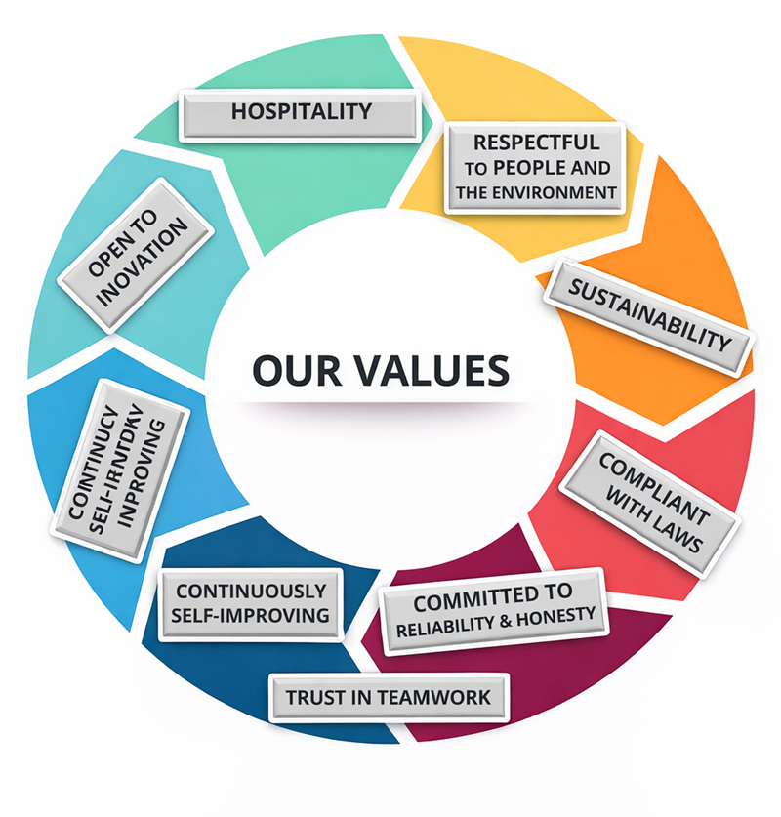
3.OUR VALUES, OUR VISION AND OUR MISSION
3.1. Our Values:
Our values define who we are, what we stand for, and how we should behave. They guide us in increasing guest satisfaction in tourism and acting in a way that builds trust between us and our guests. By working in line with our values, we determine how we should treat our guests and each other, the quality of the work we do, and the activities that lead us to success.
At the core of everything for us is the trust that our guests, stakeholders, and employees place in Kar’s Hotel, along with our conduct that upholds high standards.
3.2. Our Vision:
To become a leading hotel that embraces sustainable tourism with the principle of “not consuming the world, but living while protecting it.”
3.3. Our Mission:
To provide quality and customer-oriented service that preserves historical and cultural values and respects the natural environment.

Slide 5
4. ORGANIZATIONAL CHART AND JOB DESCRIPTIONS
ENVİRONMENTAL REPRESENTATİVE
Ö.Doğan İLİNGİ
EMPLOYEE AND GUEST REPRESENTATİVE
Deniz URUN
ACCESSİBİLTY
Mehmet DUMAN
ENERGY AND WATER MANAGEMENT REPRESENTATİVE
Metin BEKİR
SUSTAİNABİLİTY TEAM LEADER
Mehmet DUMAN
4.1. Sustainability Team
A dedicated team responsible for sustainability has been established at our hotel, and sustainability roles are clearly defined within our organizational chart.
4.2. Responsibilities and Monitoring
The responsibilities of each department are clearly outlined, and the sustainability team regularly monitors practices through scheduled meetings.

Slide 6

5. SUSTAINABILITY PRACTICES, VISUALS, GOALS, AND CONTINUOUS IMPROVEMENT
5.1. Environmental Sustainability
5.2. Social Sustainability
5.3. Cultural Sustainability
5.4. Economic Sustainability
5.5. Data Analysis and Targets
5.6. Continuous Improvement

Slide 7


Environmental Sustainability
Dual-flush toilet systems are implemented to promote water conservation.
Water consumption is monitored daily, monthly, and annually on a regional basis.
High energy-efficiency devices and LED lighting are preferred.
Key card room systems are used to prevent unnecessary energy consumption.
MSDS (Material Safety Data Sheets) are obtained for all chemicals, and natural products are preferred.
Spill trays and leak-proof measures are in place for chemical storage.

Slide 8

5.2. SOCİAL SUSTAİNABİLİTY
Contributions are made to social projects through collaboration with local communities.
A fair and inclusive work environment is provided through diversity and inclusion policies.
Staff development is supported through training, rewards, and events.

Slide 9

5.3. Cultural Sustainability
• Local cuisine is being introduced, and brochures providing information about cultural heritage are being offered.
• Local products are being promoted. Kars Kashar Cheese is served to guests at breakfast.

Slide 10
5.4. ECONOMIC SUSTAINABİLİTY
• Shopping is done from local suppliers, and referrals are made to nearby restaurants and spas.
• Management policies have been established for economic risks.

Slide 11
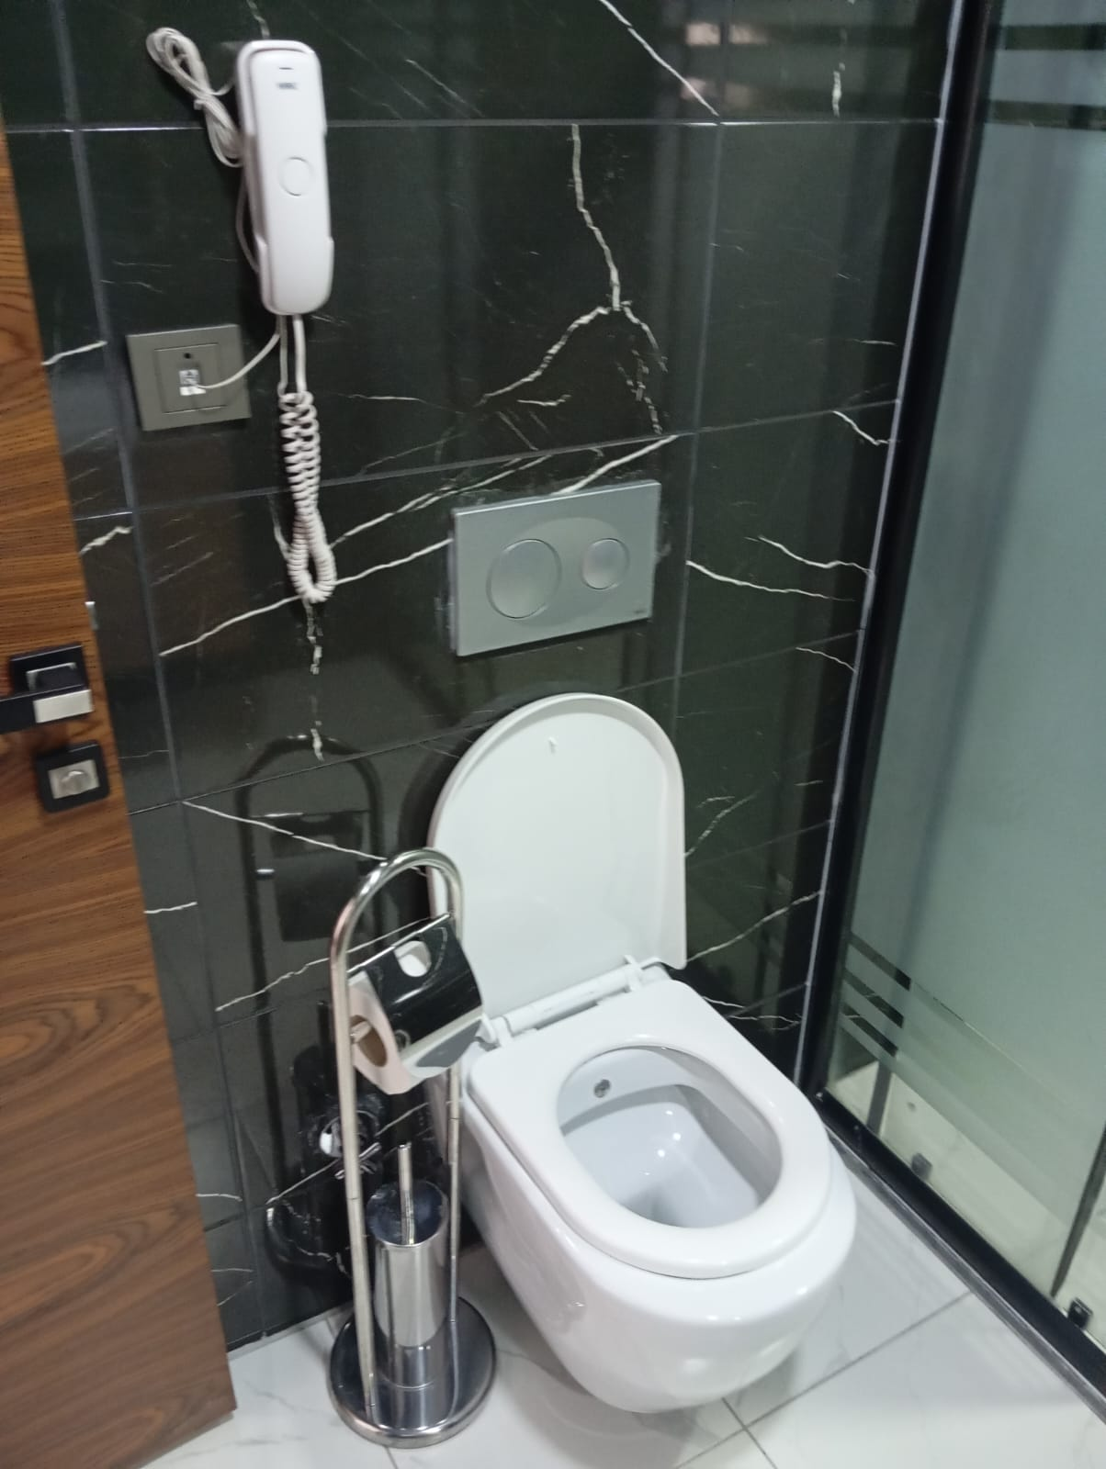
5.5 Data Analysis and Objectives
WATER CONSUMPTION
OUR GOALS
The toilet cisterns in the bathrooms are equipped with a dual-flush system to save water.
Achieve 1% per capita water savings by 2026.
Continue annual energy-saving trainings to raise staff awareness.
Prefer energy-efficient devices when purchasing new equipment.
Replace showerheads with water-saving models.

Slide 12
ELECTRICITY CONSUMPTION
OUR GOALS
Achieve 1% per capita energy savings by the end of 2026 and continue increasing this in the following years.
Continue purchasing high energy-efficiency devices.
Replace older devices with energy-efficient models.
Continue annual energy-saving trainings to inform and educate staff.
KAR’S considers the efficient use of energy resources as one of the fundamental elements of environmental sustainability. The following practices are carried out to reduce electricity consumption, lower the carbon footprint, and preserve natural resources
1.Monitoring Energy Consumption
Monthly electricity consumption is regularly monitored and recorded.
Per capita energy consumption is analyzed according to occupancy rates to identify improvement areas.

Slide 13
WASTE MANAGEMENT
OUR GOALS
Our primary goal for 2026 is to reduce the amount of paper, plastic, glass, and metal waste per overnight stay by 1% and to ensure that generated waste is properly segregated and recycled.
Participation in and the duration of annual environmental trainings will continue to increase to further raise staff awareness..
Guests and staff will be informed about waste management and made aware through various communication methods.
Waste Management Policy
KAR’S OTEL is committed to reducing waste generation at the source, segregating waste for recycling, and ensuring disposal in compliance with legal regulations in order to minimize its environmental impact.
Waste Reduction
Practices have been adopted to reduce the use of single-use products.
Bulk purchases and large packaging are preferred to minimize packaging waste.
Digital documentation is preferred to reduce paper consumption.
Waste Segregation
Paper, plastic, glass, and metal waste are collected separately within the facility.
Segregation bins are available in common areas for guest use.
Waste is delivered to licensed recycling companies.
Organic Waste Management

Slide 14

CARBON FOOTPRİNT
Our 2026 Goals
Reduce our carbon footprint by 1% and integrate carbon offsetting efforts into our daily operations and activities throughout the year.
Encourage our guests and staff to use low-carbon transportation options, such as public transport and the metro.
Plan to reduce and ultimately eliminate waste generation.
Implement measures to reduce electricity consumption.
Implement measures to reduce water consumption.
Implement measures to reduce natural gas consumption.
Monitor and implement measures to reduce paper consumption.
Aim to use raw materials from sustainable sources.
Benefit from local suppliers and employment opportunities.
When selecting suppliers, give priority to their sustainability and environmental responsibility.

Slide 15

5.6. CONTINUOUS IMPROVEMENT
Sustainability goals are updated annually and monitored using tracking tables.
It is believed that sustainable tourism is not only about practices but also a developing culture.

Slide 16
6. Personnel and Working Life
We are a big family that believes in teamwork, where employees stay with the organization for many years, everyone is evaluated under equal conditions, and those who wish to develop themselves are supported, while taking guest expectations into account and working with the warmest hospitality.
In accordance with the annual training program, our employees are provided with environmental trainings. The trainings cover topics such as reducing the consumption of natural resources, minimizing and properly segregating waste, and procedures related to hazardous waste. Trainings are conducted using both internal and external resources.
Our employees receive Occupational Health and Safety Training, Environmental Awareness and Waste Management Training, Sustainable Tourism Trainings, and Energy and Water Saving Trainings to enhance their awareness. All employees working in food-related areas also receive hygiene training.
In addition, to ensure higher-quality and dedicated communication with our conscious staff, trainings on communication skills, prevention of child abuse, and gender equality are also provided.
After completing these trainings, our staff fully understands what we do for Sustainable Tourism, the targets of our implemented practices, and how they can contribute to these practices within our facility.

Slide 17
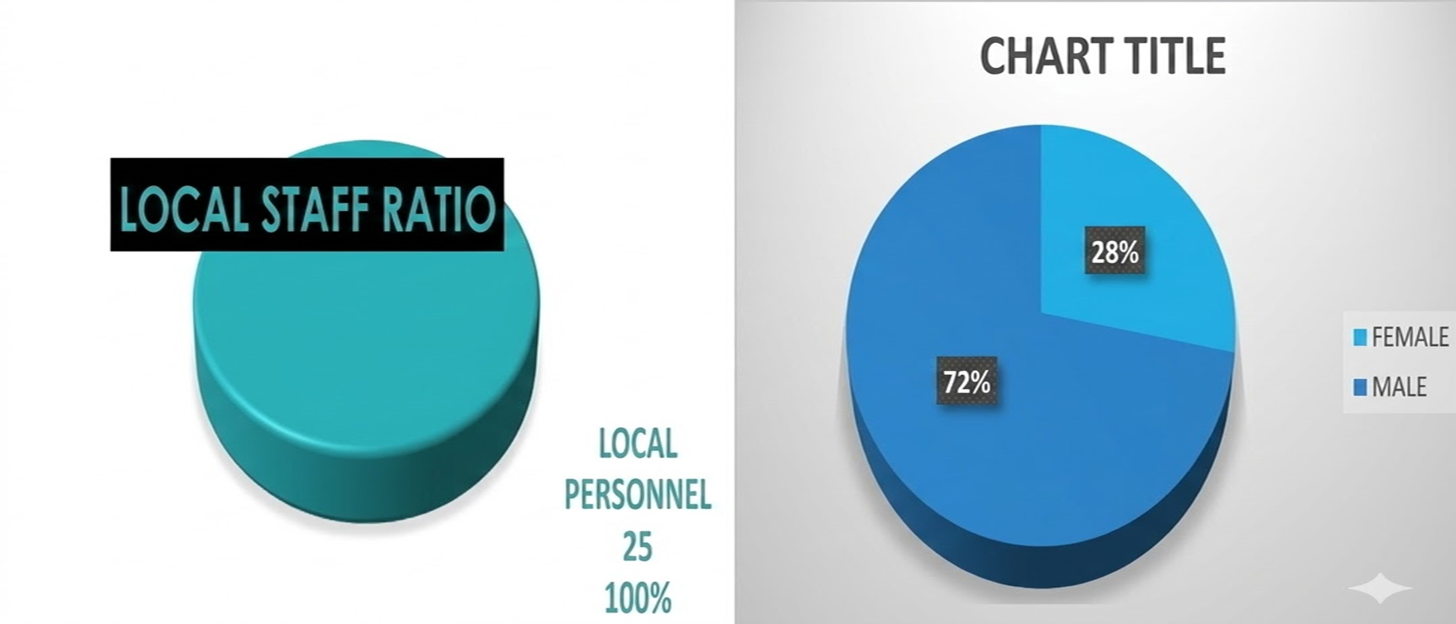
6.1 STAFF DISTRIBUTION
LOCAL STAFF RATIO
GENDER DISTRIBUTION OF EMPLOYEES

Slide 18
6.2. FACILITIES OFFERED TO PERSONNEL
Staff Cafeteria:
Meals served in the staff cafeteria are free of charge for employees.
With menus that change every two weeks, the staff cafeteria provides breakfast, lunch, and dinner (3 meals) for employees.
Holiday Bonus; Our employees are given bonuses during religious holidays.

Slide 19
7. COMMUNICATION WITH STAKEHOLDERS
Continuous interaction with internal stakeholders (staff) is ensured through meetings, surveys, and trainings.
Regular contacts are maintained with external stakeholders (NGOs, local authorities, suppliers, guests) to share information about sustainability efforts.
Guest complaints and suggestions are taken into account to continuously improve service quality.

Slide 20
8. LEGAL REGULATIONS AND COMPLIANCE
Zero Waste Regulation
Environmental Law and Water Pollution Control Regulation
Occupational Health and Safety Law
Personal Data Protection Law (KVKK)
Tourism Facilities Regulation and GSTC Criteria

Slide 21

9. Customer Satisfaction
Continuous interaction with guests is ensured through digital and physical surveys and the contact section on the website.
Google reviews and survey results are regularly monitored to implement improvements.
Service quality is measured through surveys, with a target of 100% satisfaction.

Slide 22
10. Biodiversity, Wildlife Conservation, and Destination Engagement
Contributions to nature are made annually through tree donations in collaboration with the TEMA Foundation.
Donations are made to the ÇEKÜL Foundation for the protection of cultural heritage.
Endemic plants around the hotel are introduced, raising guest awareness.

Slide 23

11.CONCLUSION
As Kars Hotel, we regard sustainability as an integral part of our business.
We aim to set an example for the sector with a business approach that is in harmony with society, the environment, and the economy.
In order to leave a livable world for future generations, we will continue working together with all our staff and stakeholders.

